Slide 1


PHOTO.LO.GUE
PHASE 0 - RMT 006 - KAMAL
CAPTURE EVERY PRECIOUS Moment With Us
JULY 2024

Slide 2

TABLE OF CONTENT
01
About Me
02
Problems & Solutions
03
Tech Stack

Slide 3
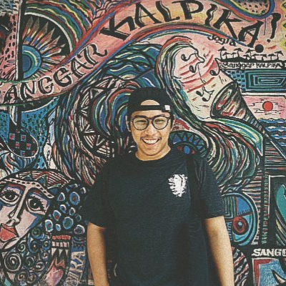

HELLO FRIENDS!
GREETING FROM ME
Hi there! I'm Kamal, an International Relations graduate who's found a new love in the IT world. Currently, I'm joining the Golang Hacktiv8 course, aiming to become a pro from the ground up. I'm excited to build a stunning portfolio and can't wait to connect with all of you and mentors who share my enthusiasm. Let's learn, grow, and create amazing things together!

Slide 4

PROBLEMS
01
Challenges Find Photographer
Finding a photographer while vacationing in Jakarta, Jogja, and Bali is challenging, making it difficult to capture spontaneous, leaving your beautiful memories undocumented.
02
Hard to Find Your Needs
Comparing photographer portfolios and inquiring about prices individually can be quite challenging. This process is time-consuming and often frustrating, Consequently, finding the perfect fit for your needs becomes tiresome task.

Slide 5


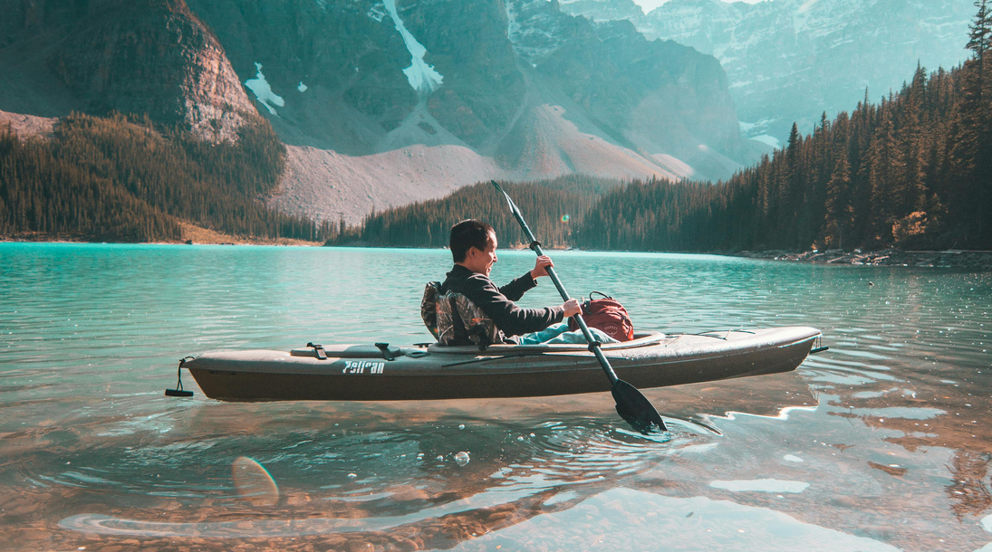
OUR SERVICE
WHAT WE COULD DO
Effortless Portfolio Viewing
Seamless Find Photographer
Book Photographer
Viewing photographer portfolios and prices is now simple with one website, allowing you to compare options effortlessly.
Easily find and view photographer locations, simplifying the process of connecting with best photographer near you.
Easily book photographers, check availability, and view prices on our platform, simplifying the process of finding the best and perfect photographer for your needs.

Slide 6

TECH STACK

Slide 7
QUESTION ?

Slide 8
THANK YOU

